Slide 1
  Color Image Processing
CUI, Lahore Campus -- CSC 331: Digital Image Processing -- © Dr. Usama Ijaz Bajwa

Slide 2
Color Image Fundamentals
Color perception is a psychophysical phenomenon that combines two main components:
  The physical properties of light sources (usually expressed by their spectral power distribution, SPD) and surfaces (e.g., their absorption and reflectance capabilities).
  The physiological and psychological aspects of the human visual system (HVS).
CUI, Lahore Campus -- CSC 331: Digital Image Processing -- © Dr. Usama Ijaz Bajwa

Slide 3
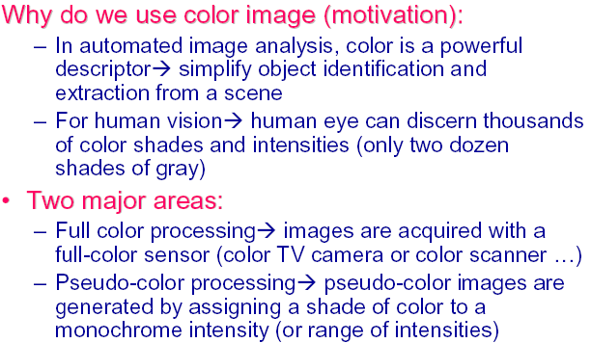
Color Image Fundamentals
CUI, Lahore Campus -- CSC 331: Digital Image Processing -- © Dr. Usama Ijaz Bajwa

Slide 4
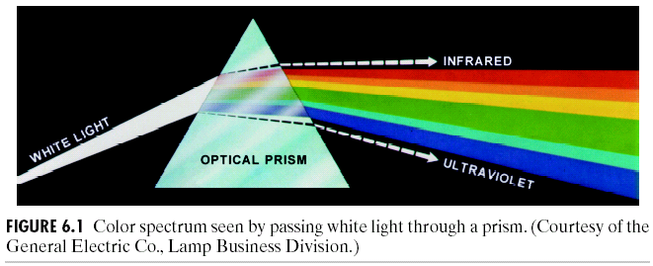
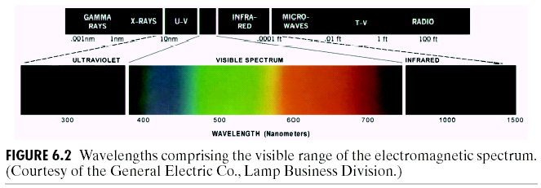
Color Image Fundamentals
CUI, Lahore Campus -- CSC 331: Digital Image Processing -- © Dr. Usama Ijaz Bajwa

Slide 5
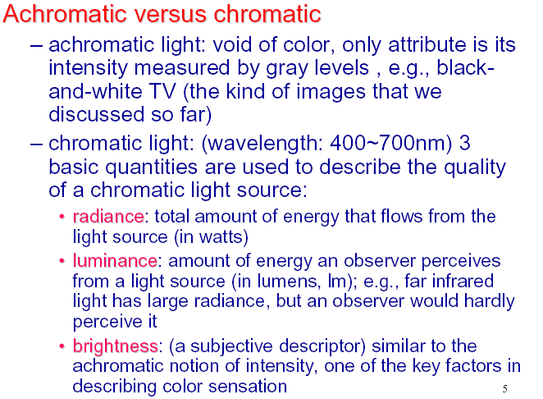
Color Image Fundamentals
CUI, Lahore Campus -- CSC 331: Digital Image Processing -- © Dr. Usama Ijaz Bajwa

Slide 6
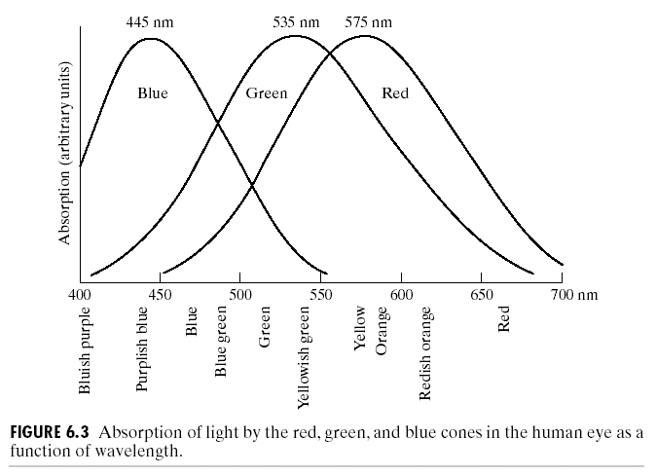
Response of human eye to different colors
CUI, Lahore Campus -- CSC 331: Digital Image Processing -- © Dr. Usama Ijaz Bajwa

Slide 7
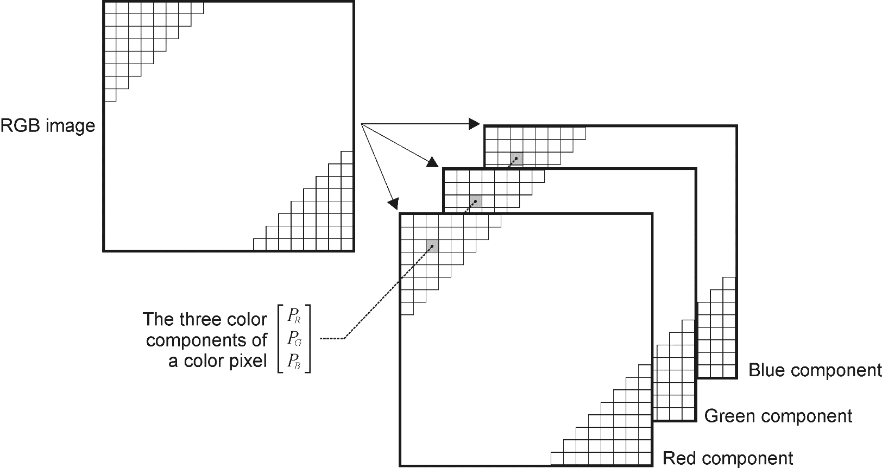
Color Images in MATLAB
  RGB
CUI, Lahore Campus -- CSC 331: Digital Image Processing -- © Dr. Usama Ijaz Bajwa

Slide 8
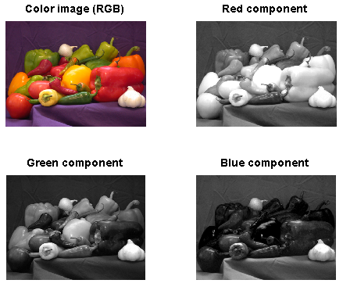
Color Images in MATLAB
I = imread(’peppers.png’);
size(I)
class(I)
subplot(2,2,1), imshow(I), title(’Color image (RGB)’)
subplot(2,2,2), imshow(I(:,:,1)), title(’Red component’)
subplot(2,2,3), imshow(I(:,:,2)), title(’Green component’)
subplot(2,2,4), imshow(I(:,:,3)), title(’Blue component’)
CUI, Lahore Campus -- CSC 331: Digital Image Processing -- © Dr. Usama Ijaz Bajwa

